Slide 1



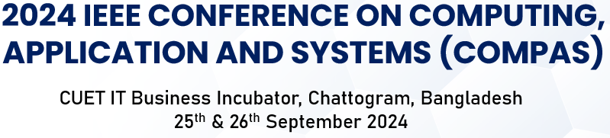



2024 IEEE CONFERENCE ON COMPUTING,
APPLICATION AND SYSTEMS (COMPAS)
CUET IT Business Incubator, Chattogram, Bangladesh
25th & 26th September 2024
Paper ID:
256
Topic:
Eye Disease Detection And Classification Using Deep Learning: A Comperative Study
Md AL Emran
Department of EEE
Pabna University of Science and Technology
Pabna, Bangladesh

Slide 2


Outline of Presentation
Abstract
Introduction
Literature Review
Methodology
Proposed Work
Result and Discussion
Conclusion
Reference
1
CUET IT Business Incubator, Chattogram, Bangladesh 25th & 26th September 2024

Slide 3
Abstract
Issue and Objective: The need for a deep learning model to detect eye diseases using retinal images. The aim to improve detection of diseases like diabetic retinopathy, cataract, and glaucoma using CNN models.
Methodology: The use of Convolutional Neural Networks (CNNs), specifically EfficientNet-B3 and Xception. Application of models for both training and testing, with a focus on accuracy and precision.
Results: Achieved 100% accuracy in training and 94% accuracy in testing, showing minimal loss. Exceptional performance in precision, recall, and F1-score, achieving 100% in all metrics.
Conclusion: The proposed deep learning approach is more efficient and accurate compared to traditional methods. This approach can assist medical professionals and researchers in improving diagnostic capabilities.
2
CUET IT Business Incubator, Chattogram, Bangladesh 25th & 26th September 2024

Slide 4
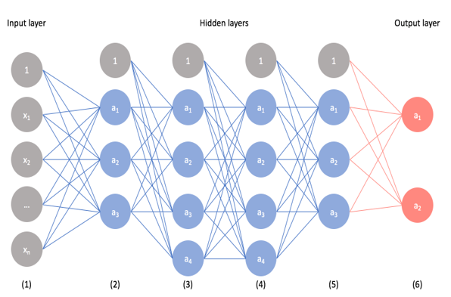
Introduction
Eye diseases detection like Glaucoma, Cataract and Diabetic Retinopathy compared to normal eye.
Effective treatment requires an early diagnosis, and identifying in retinal image analysis.
Using Deep learning for Eye Disease:
Computer-aided diagnosis (CAD) systems seek to support medical professionals
Medical image analysis by pre-trained Convolutional Neural Network (CNN) Transfer Learning
CNN Architecture
Making of trustable pathologist's decision-support tool and getting more accurate results
3
CUET IT Business Incubator, Chattogram, Bangladesh 25th & 26th September 2024

Slide 5
Literature Review
Author | Used Models | Results
Tariq, Hassan et al | Inception ResNet V2, GoogleNet, AlexNet, ResNeXt-50, and Inception V4 | 84% accuracy
Londhe, Mayuresh et al | LSTM, InceptionV3, InceptionResNetV2, and DenseNet 169 | 70.01% accuracy
Krishna Prasad et al | Decision Tree, Random Forest, and XGBoost | 84% accuracy
Kaushik S Kalmady et al | VGG16 | accuracy of 85%
Angelo Genoves et al | Xception, VGG16, VGG19 | Accuracy 81%
Md.Mehedi Hasan et al | DenseNet201 | Accuracy of 79%
4
CUET IT Business Incubator, Chattogram, Bangladesh 25th & 26th September 2024

Slide 6
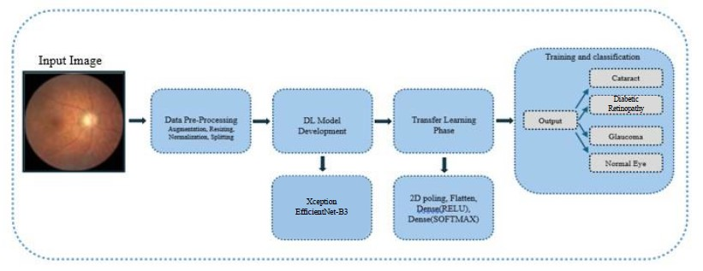
Methodology
Number of images: 4200
Number of categories: 4
Image size used: 224x224 pixels.
Image format: RGB
Classes: 3 disease cells, Normal cells.
Data source: Kaggle
With a ratio of 70%:15%:15%, divide the dataset into training, validation, and test sets. This yields 3000 images for training, 600 images for validation, and 600 images for testing
Fig: Transfer Learning Architecture Block Diagram
5
CUET IT Business Incubator, Chattogram, Bangladesh 25th & 26th September 2024

Slide 7
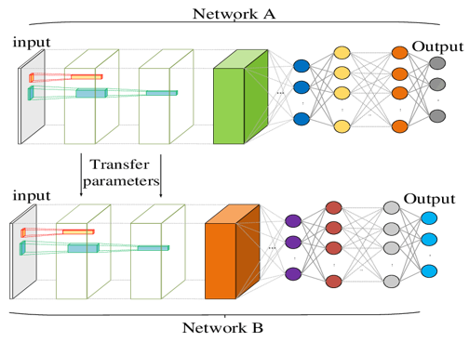
Proposed Work
Technology Used
TensorFlow, in Python programming language
OpenCV (Open Computer Vision Library), in Python programming language.
Development tools
Kaggle (Online platform with GPU support)
Google Colab (online platform with GPU support)
Fig: Transfer Learning Architecture Block Diagram
6
CUET IT Business Incubator, Chattogram, Bangladesh 25th & 26th September 2024

Slide 8




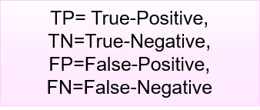
Result and Discussion
Model | Train Loss | Validation Loss | Test Loss | Train Accuracy | Validation Accuracy | Test Accuracy
Xception | 0.15 | 0.31 | 0.40 | 99.97% | 95% | 92%
EfficientNet-B3 | 0.14 | 0.33 | 0.33 | 100% | 94% | 94%
Equations for Result Evaluation
Models | Classes | Precision | Recall | F1-score
Xception | Cataract | 0.93 | 0.96 | 0.95
 | Diabetic Retinopathy | 0.98 | 1.00 | 0.99
 | Glaucoma | 0.90 | 0.82 | 0.86
 | Normal | 0.86 | 0.90 | 0.88
EfficientNet-B3 | Cataract | 0.96 | 0.97 | 0.97
 | Diabetic Retinopathy | 1.00 | 1.00 | 1.00
 | Glaucoma | 0.91 | 0.89 | 0.90
 | Normal | 0.90 | 0.91 | 0.90
7
CUET IT Business Incubator, Chattogram, Bangladesh 25th & 26th September 2024

Slide 9
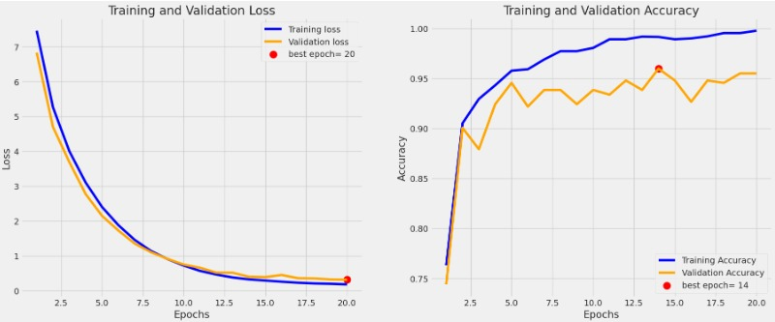
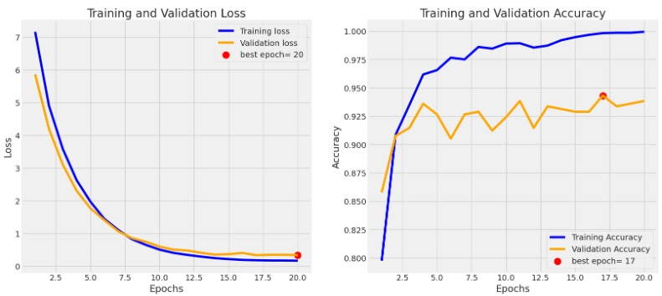
Result and Discussion
Fig: Xception (0.188 validation loss)
Fig: EfficientNet-B3 (0.302 validation loss)
Important Notes:
(Over 94% validation, 99.97% train, and 94% test accuracy) EfficientNetB3, Xception
EfficientNet-B3 & test phase more than 94% accuracy, True : False= 564 : 36 (Confusion matrices)
Xception & test phase more than 92% accuracy, True : False= 552 : 48 (Confusion matrices)
8
CUET IT Business Incubator, Chattogram, Bangladesh 25th & 26th September 2024

Slide 10
Conclusion
Promotes innovation in eye disease diagnostics
99.97% accuracy from two different models, 97% precision, 98% recall, and 97% f1-score among two different models.
Useful clinical applications and utilize larger datasets encompassing various eye disease subtypes, image qualities and improve robustness
Consider collaborating with medical institutions for wider data access employ better data augmentation techniques like flipping, rotating, and zooming to balance the dataset
Acting as a springboard for further research and Real world compared to conventional diagnostic techniques, conduct thorough clinical trials
9
CUET IT Business Incubator, Chattogram, Bangladesh 25th & 26th September 2024

Slide 11
Reference
[1]“Glaucoma | National Eye Institute.” Accessed: Jul. 04, 2024. [Online]. Available: https://www.nei.nih.gov/learn-about-eye-health/eye-conditions-and-diseases/glaucoma
[2]“Cataracts | Johns Hopkins Medicine.” Accessed: Jul. 04, 2024. [Online]. Available: https://www.hopkinsmedicine.org/health/conditions-and-diseases/cataracts
[3]M. Asirvatham, M. Vijayaraj, T. Manikandan, A. Vignesh, E. E. Nithila, and J. N. Jothi, “Hybrid Deep Learning Network to Classify Eye Diseases,” in 2022 6th International Conference on Trends in Electronics and Informatics, ICOEI 2022 - Proceedings, Institute of Electrical and Electronics Engineers Inc., 2022, pp. 1335–1342. doi: 10.1109/ICOEI53556.2022.9776916.
[4]Y. C. Tham, X. Li, T. Y. Wong, H. A. Quigley, T. Aung, and C. Y. Cheng, “Global prevalence of glaucoma and projections of glaucoma burden through 2040: A systematic review and meta-analysis,” Ophthalmology, vol. 121, no. 11, pp. 2081–2090, Nov. 2014, doi: 10.1016/j.ophtha.2014.05.013.
[5]Y. Cui, R. Sun, B. Liu, Z. Liu, and T. T. Toe, “Eye Diseases Classification Using Transfer Learning of Residual Neural Network,” in 2023 3rd International Symposium on Computer Technology and Information Science, ISCTIS 2023, Institute of Electrical and Electronics Engineers Inc., 2023, pp. 244–248. doi: 10.1109/ISCTIS58954.2023.10213138.
[6]K. S. Grover and N. Kapoor, “Detection of Glaucoma and Diabetic Retinopathy Using Fundus Images and Deep Learning,” in 5th IEEE International Conference on Cybernetics, Cognition and Machine Learning Applications, ICCCMLA 2023, Institute of Electrical and Electronics Engineers Inc., 2023, pp. 407–412.doi: 10.1109/ICCCMLA58983.2023.10346704.
[7]D. Selvathi, K. Suganya, and / Pg Student, “Support Vector Machine Based Method for Automatic Detection of Diabetic Eye Disease using Thermal Images.”
[8]M. Shreya, S. Shah, and J. W. Bakal, “Deep Learning for the Detection of Diabetic Retinopathy,” 2022. [Online]. Available: www.ijraset.com
[9]R. Singh, N. Sharma, and R. Gupta, “The Proposed Convolutional Neural Network Architecture for the Detection and Classification of Eye Diseases,” in 2023 IEEE International Conference on Research Methodologies in Knowledge Management, Artificial Intelligence and Telecommunication Engineering, RMKMATE 2023, Institute of Electrical and Electronics Engineers Inc., 2023. doi: 10.1109/RMKMATE59243.2023.10368670.
[10]M. S. H. Shojol, M. A. I. Siddique, and F. Haque, “Enhanced Convolutional Neural Networks for Early Detection and Classification of Ophthalmic Diseases,” in 2023 International Conference on Information and Communication Technology for Sustainable Development, ICICT4SD 2023 - Proceedings, Institute of Electrical and Electronics Engineers Inc., 2023, pp. 209–213. doi: 10.1109/ICICT4SD59951.2023.10303558.
10
CUET IT Business Incubator, Chattogram, Bangladesh 25th & 26th September 2024

Slide 12
Thank You !
CUET IT Business Incubator, Chattogram, Bangladesh 25th & 26th September 2024

Slide 13
Any Question !
CUET IT Business Incubator, Chattogram, Bangladesh 25th & 26th September 2024

